Slide 1
Monitoring Quality of HIV Testing Services: Ghana’s Experience with the Dried Tube Specimen Proficiency Testing Programme
RTCQI WORKSHOP (BEST PRACTICES)
Cape Town, South Africa
3-7 June 2024
Rowland Adukpo, Francis Frimpong, Kwasi Boaheng, Clement Evans Aryee

Slide 2
Outline of Presentation
Background
Facility selection and training
Panel Preparation and Distribution
Data Analysis and results dissemination
Lessons learned
Challenges
Way Forward
Conclusion

Slide 3

Background 1/2
Ghana adopted the WHO recommendations to “TREAT ALL” in 2016 towards achieving 90-90-90 (now 95-95-95 UNAIDS targets)
Burden to ensure the first 95 is properly done
Innovative & pragmatic approaches like dHTS is being implemented to help us achieve the first 95
Despite significant scale up, first 95 still far from attainment
There is a need to focus on the quality of dHTS

Slide 4

Background 2/2
Adoption of the three-test serial algorithm imposes a major burden on monitoring testing quality in the country
The test kits currently in use are ;
First Response, Oraquick and Bioline for General Population and Non-Pregnant Women
First Response HIV/Syphilis Combo, Oraquick, and Bioline for ANC Clients or Pregnant Women
There is therefore an increased need to put in place a system for ensuring the quality of HIV test results accurate and reliable
Hence the EQA program to support the testing facilities

Slide 5

Background to HIV RT EQA Program in Ghana
Started with liquid serum or plasma specimens sent to 40 HIV sentinel sites in 2008.
Challenges:
Require cold storage during transportation
Costly
Risk of Bio-hazard spill
It was discontinued after two rounds

Slide 6

DTS PT Program in Ghana
Received training from CDC on DTS PT in March 2010
DTS PT program for HIV rapid testing started in March 2011(CDC ,GHSS)
Piloted in 37 facilities across the Greater Accra Region
Sites participated in three rounds of PT sample distribution
Scaled up nationwide to 542 testing sites in 2013
Program was administered by the NPHRL

Slide 7
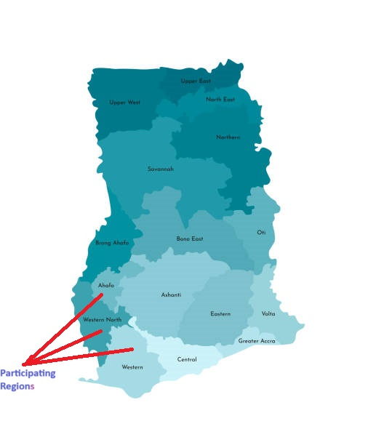
Coverage of the Current DTS PT Programme

Slide 8

Site selection and Training of Facilities
Major criteria for enrollment of facility in the DTS PT programme is disease burden
Participants from the enrolled facilities are invited to conference-type training
A certificate of participation is awarded to all participants

Slide 9
Coverage of the Current DTS PT Programme Cont’d
Number of Regions | 3 out of 16
Number of Facilities | 232
Testing Points | 408
Breakdown of Testing Points
Testing Points
Region | ANC | ART | LAB | OPD | RCH | Total
Western | 97 | 36 | 62 | 3 | 1 | 199
Western North | 57 | 8 | 30 | 3 | 0 | 98
Ahafo | 60 | 16 | 30 | 5 | 0 | 111
Total | 214 | 60 | 122 | 11 | 1 | 408

Slide 10

Panel Preparation and Distribution
The panels are prepared by the Sekondi Public Health Laboratory according to the standard protocol
Separate panels are prepared for participants from the antenatal clinics to include assessment for syphilis testing
Panels are sent to the National AIDS/STI Control Programme for QA and distribution
Distribution of the panels is done through the Regional and District/Zonal teams to the facilities

Slide 11
Results Collection, Analysis and Dissemination
Results are submitted to the Programme via the e-PT tool and email followed by the hard copy
Data are entered remotely by testers and national officers in the e-PT tool,
It is analyzed and feedback report generated for each sites.
A dissemination or review meeting is held for the regions after each PT round
Onsite corrective actions are conducted for sites that performed unsatisfactorily

Slide 13
Overall Performance Trends (R1-R5)

Slide 14
Lessons Learned from DTS PT Program
DTS PT results are being used as an advocacy tool to get the Regional Health Directorates to take ownership of HTS
Serves as a vehicle to build capacity for District HIV Focal persons to support programmatic (HTS) implementation
DTS PT programme provides information of commodity management at the lowest tier of the healthcare delivery system.
Helps to identify training needs of service providers in the area of testing and documentation for HIV and Syphilis

Slide 15
Challenges
High staff attrition
Non-transfer of skills to other facility staff by trained personnel
Not all eligible facilities are covered
Lack of resources to conduct monitoring and supportive supervision to sites
Non-implementation of the other pillars of RTCQI.

Slide 16
Way forward and Recommendations
Revise the HIV rapid Test Quality assurance manual
Expand DTS PT programme to facilities in the remaining 13 administrative regions of the country
Continue with the advocacy to ensure staff are posted to the facilities

Slide 17





Acknowledgments

Slide 18
                Thank you!

Slide 19






Burkina Faso HIV Serology PT program Management
Dr KIENTEGA S.SERGE
SAWADOGOYAcouba

Slide 20
PLAN
Background
1- BURKINA FASO PT PROGRAM
2- COVERAGE OF THE PT PROGRAM
3- STAKEHOLDERS AND ROLES
4- PANEL PRODUCTION AND DISTRIBUTION

Slide 21
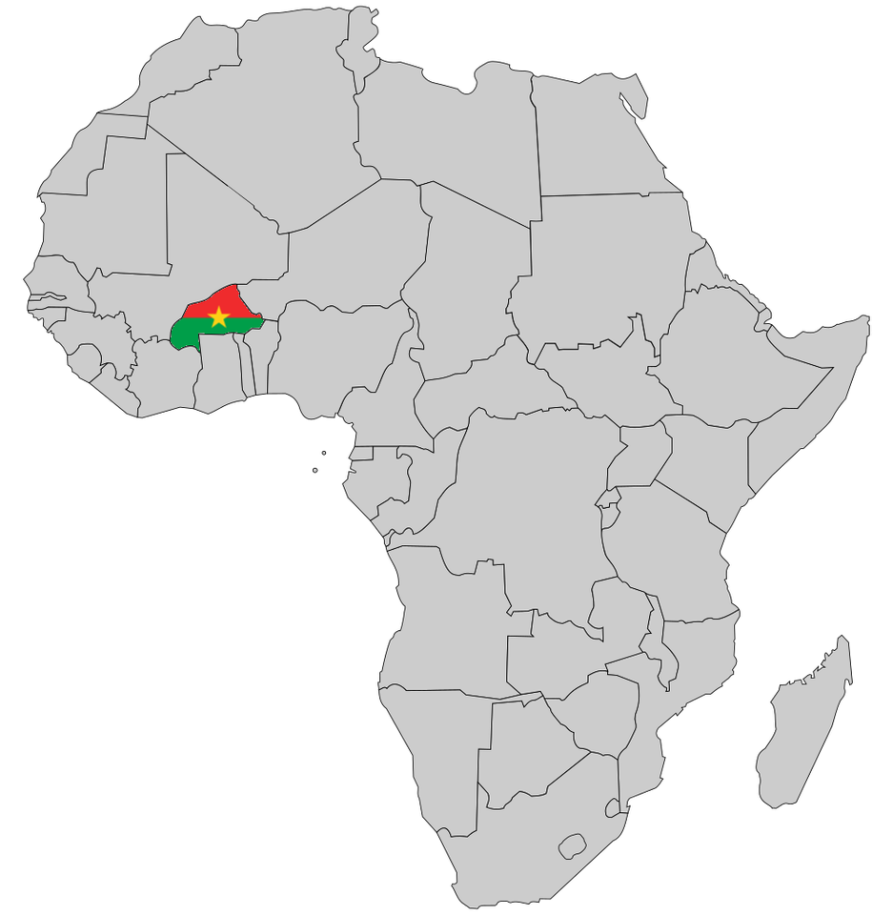


Background
Surface area: 274,500 km²
Capital: Ouagadougou
Population: 22,1 million d’habitants ( 2021)
Burkina Faso : Prevalence : 0, 7 % (SP-CNLS, 2021)
≈ 100 000 PLHIV

Slide 22



Background
-There have been various efforts to achieving an AIDS free generation:
  PEPFAR blueprint (2019) – attaining an AIDS-free generation
  Strategic vision 2021-2025
  The ‘95-95-95’ targets for 2025
  The zero new HIV infections by the year 2030
  The free of new HIV infections, stigma and AIDS related deaths
  Verification of the screening algorithm and identification of appropriate tests for HIV diagnosis (2023).
  Ensuring Zero misdiagnosis is key: need to ensure right diagnosis before initiation of ART
Implementation of a quality system for HIV screening is necessary HIV Serology PT program Management

Slide 23

1-BURKINA FASO PT PROGRAM
The program covers the following areas of medical biology:
biochemistry,
hematology,
immunology (HIV Serology PT Performance and Quality, 2023,Amref/CDC)
parasitology,
bacteriology,
molecular biology

Slide 24



1-BURKINA FASO PT PROGRAM

Slide 25
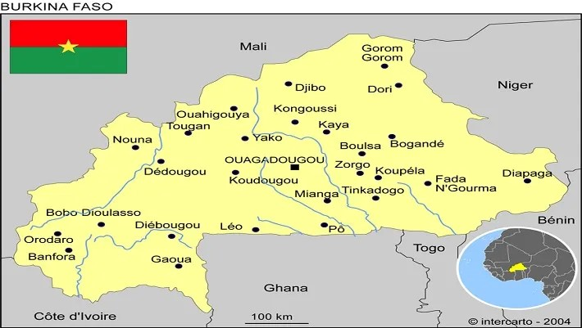
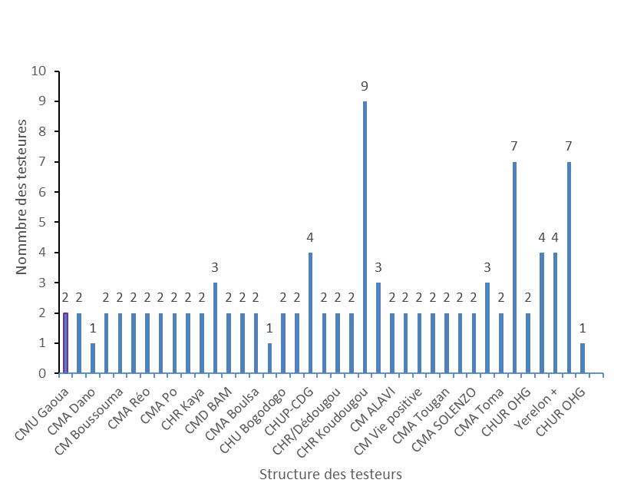
2. COVERAGE OF THE PT PROGRAM
Participant status by locality in the PT

Slide 26
3. Stakeholders AND roles
The DLBM is responsible for organizing the external quality assessment and ensures the mobilization of resources.
National reference laboratories: HIV, influenza, HPV, AMR, TB, meningitis, FHV, etc.
The national blood transfusion center (CNTS);
The national malaria research and training center (CNRFP);
The health sciences training and research unit (UFR/SDS)
The HIV program
The PTF (Amref Health Africa, FM, PandemicFUN,etc)

Slide 27
4. PANEL PRODUCTION AND DISTRIBUTION (1/7)
Steps of the implementation of EQA serology HIV
7th stage: Training testers on the use/submission of EEQ results
1st stage:Training of consultants for the teamAmref Kenya
8th stage:Receipt and analysis of results
2th stage: Participant Enrollments
3th stage: Acquisition of reagent for production
9th stage:Design of the results feedback sheet for participants
4th stage: Training of the DLBM team in panel production
10th stage:Printing and validation of results by the DLBM
5th stage: Production of panels by consultantsAmrefand the DLBM
11th stage:Individual scanning and sending of all results to participants
6th stage: Production of panels by consultantsAmrefand the DLBM
12th stage:Restitution of results and discussions for improvement

Slide 28
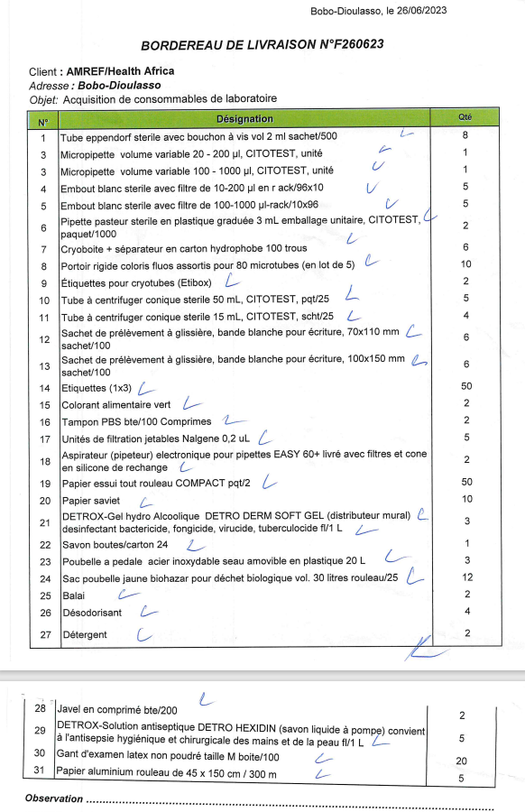
4. PANEL PRODUCTION AND DISTRIBUTION (2/7)
3th stage: Acquisition of reagent
Development of the need taking into account the number of testers
Submission of the expression of need to the team amref Health Africa of Kenya
Delivery of inputs to DLBM

Slide 29




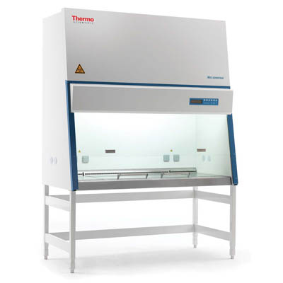
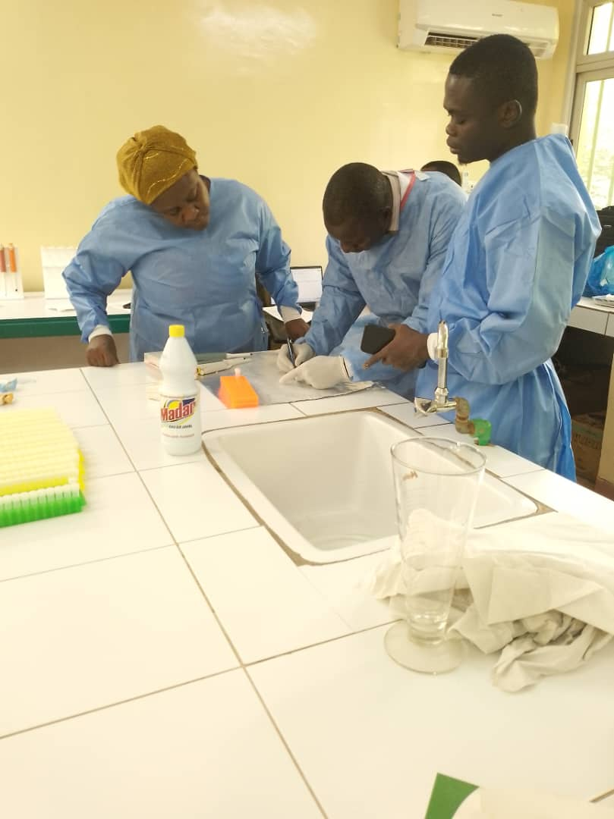
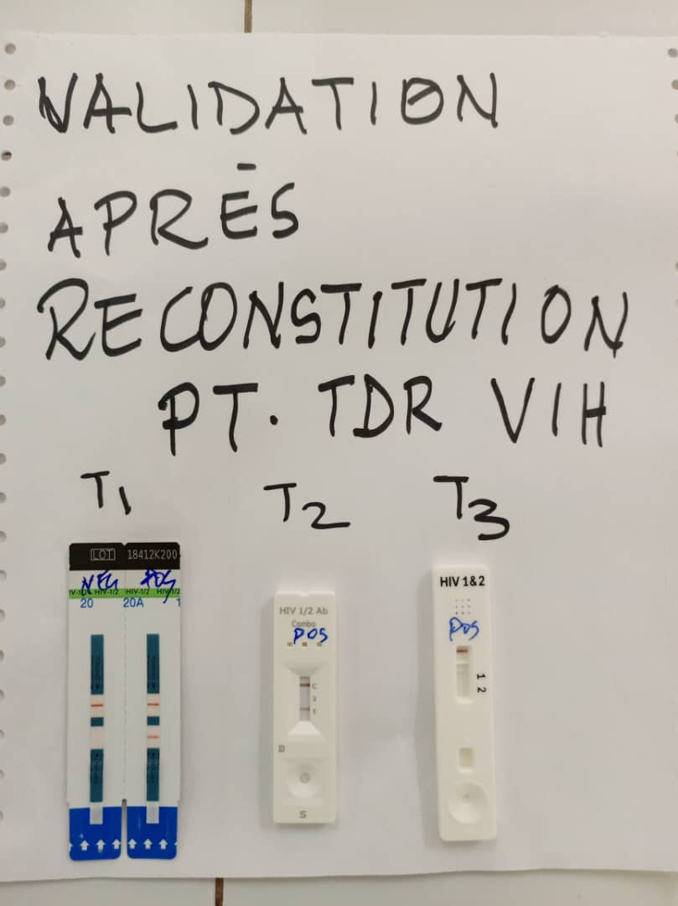
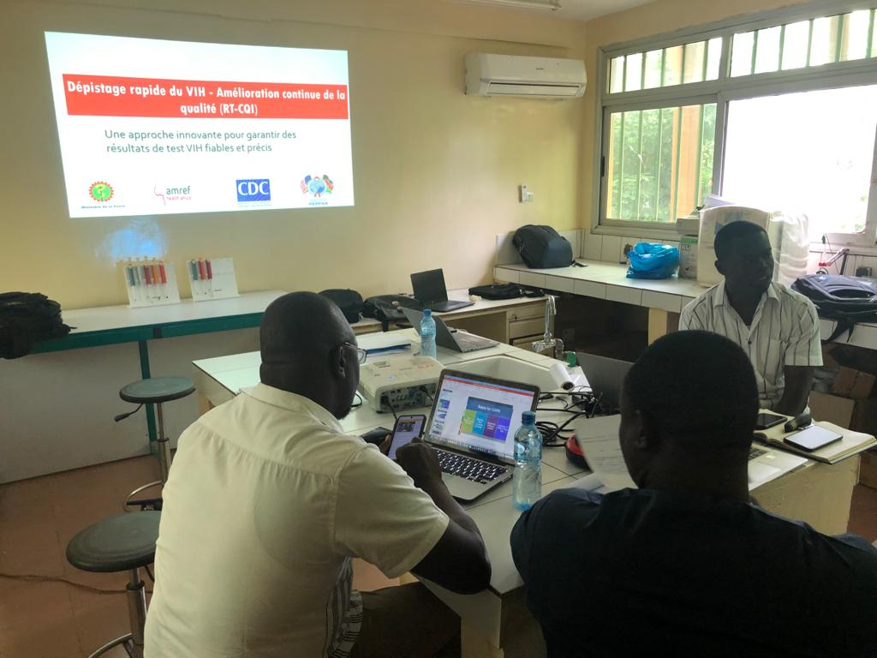
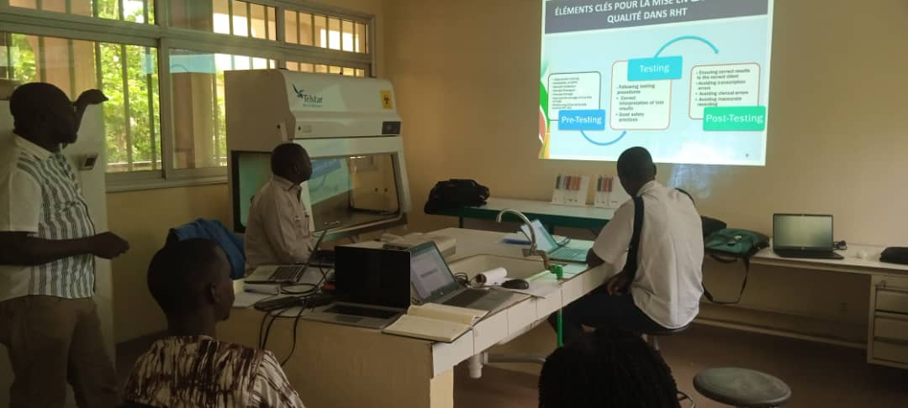
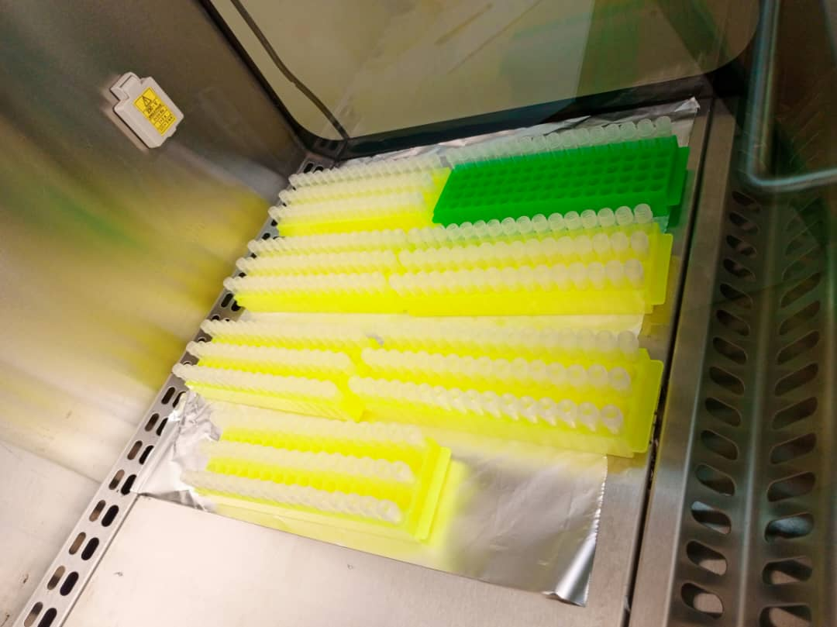
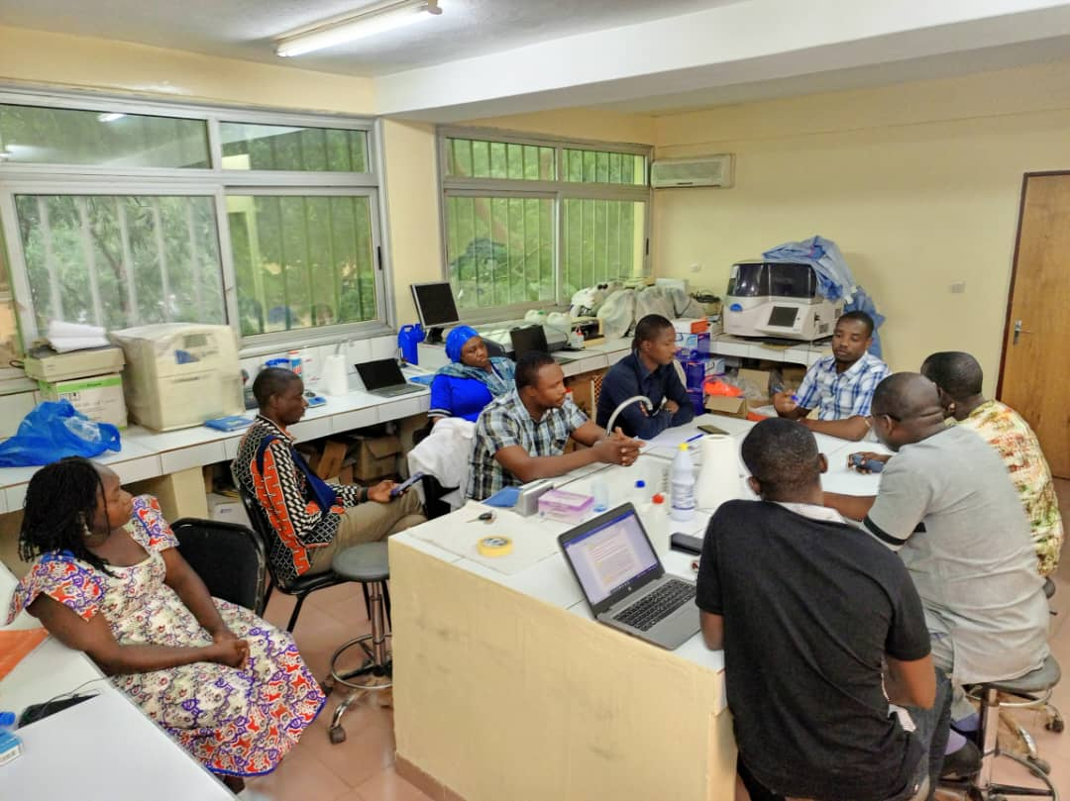
4thstep: Choice and training of the panel production site (3/7)
5thstep: Production of panels by Amref and the DLBM

Slide 30
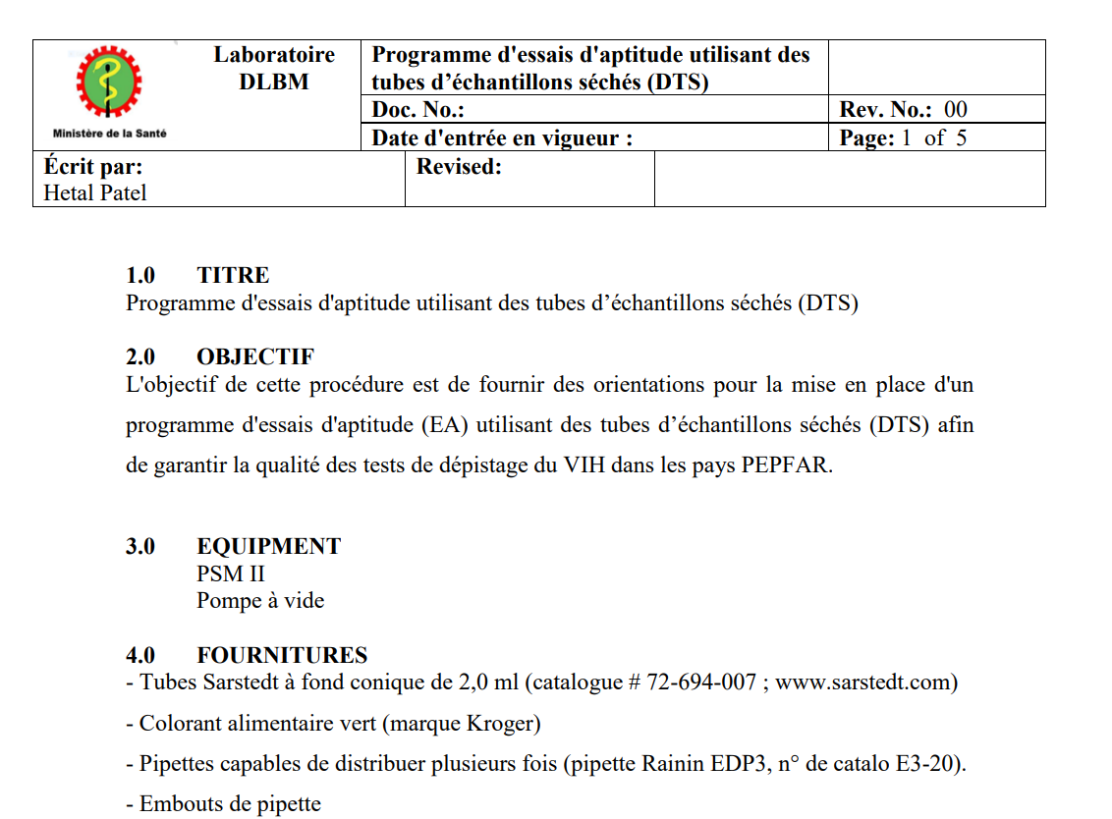

6thstep Development of Instructions and feedback sheet results that will accompany the panels (4/7)
Protocol
Instruction

Slide 31
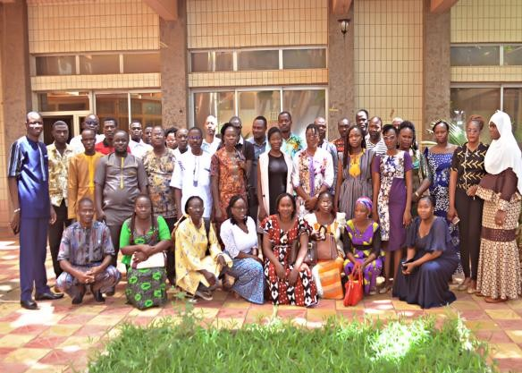
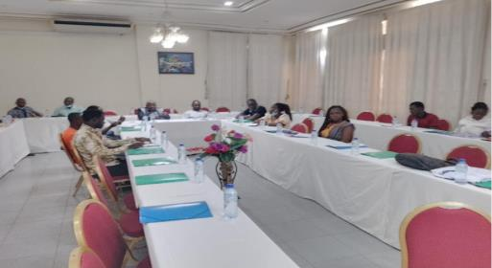
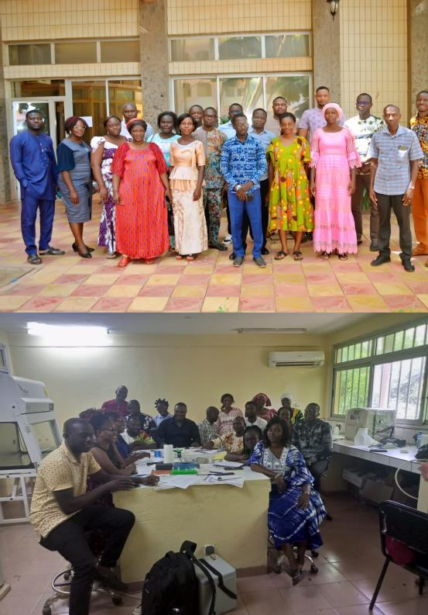
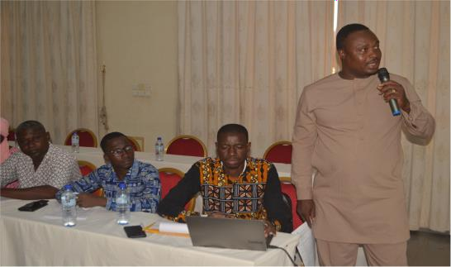
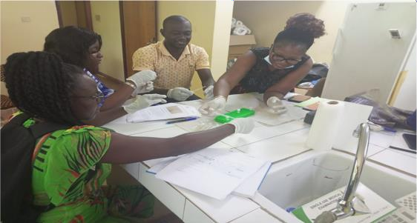
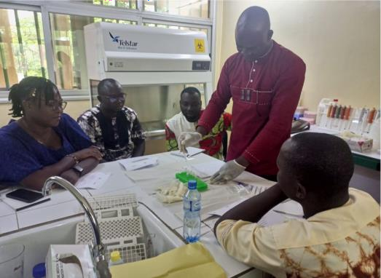
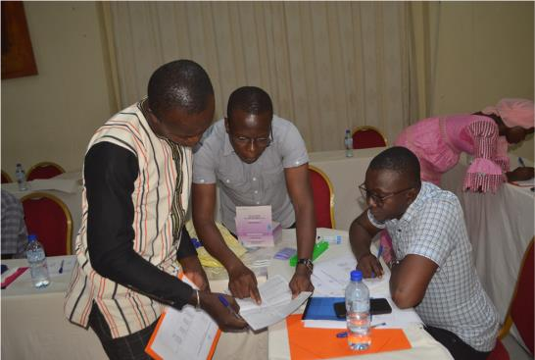
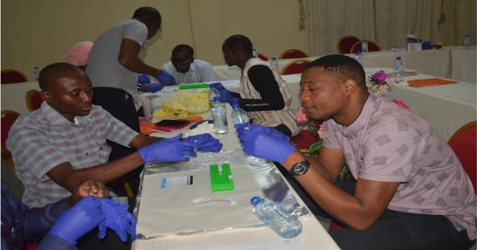
7thstep: Training testers on panel use and submission of EQA results (5/7)

Slide 32

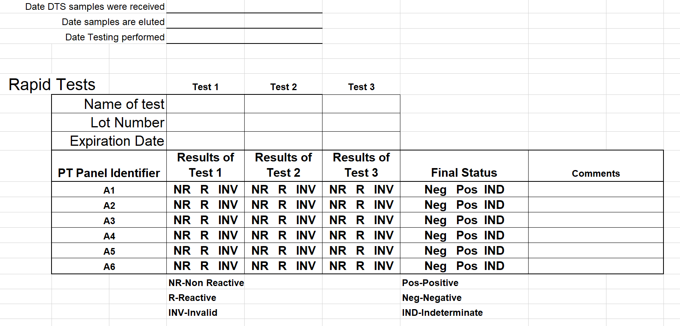

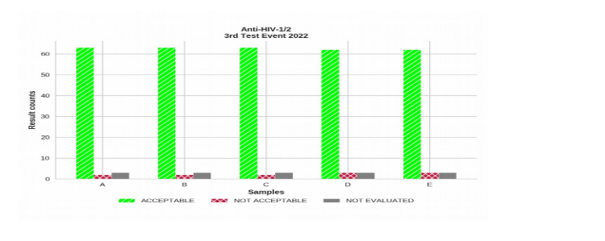
8thstage: Reception and analysis of results (6/7)
Results sent in photo/PDF by email and by WhatsApp/Mail (DLBM orAmref)
Manual analysis withexcel: Non-basic use
Codification
9thstage:Design of the results feedback sheet for participants
- The feedback form was developed by the teamAmrefdrawing inspiration from the results sheet ofAmrefKenya and the fileHuQAS

Slide 33





10thstep Printing and validation of results by the DLBM (7/7)
11thIndividual scanning and sending of all results to participants
12thRestitution of results and discussions for improvement

Slide 34
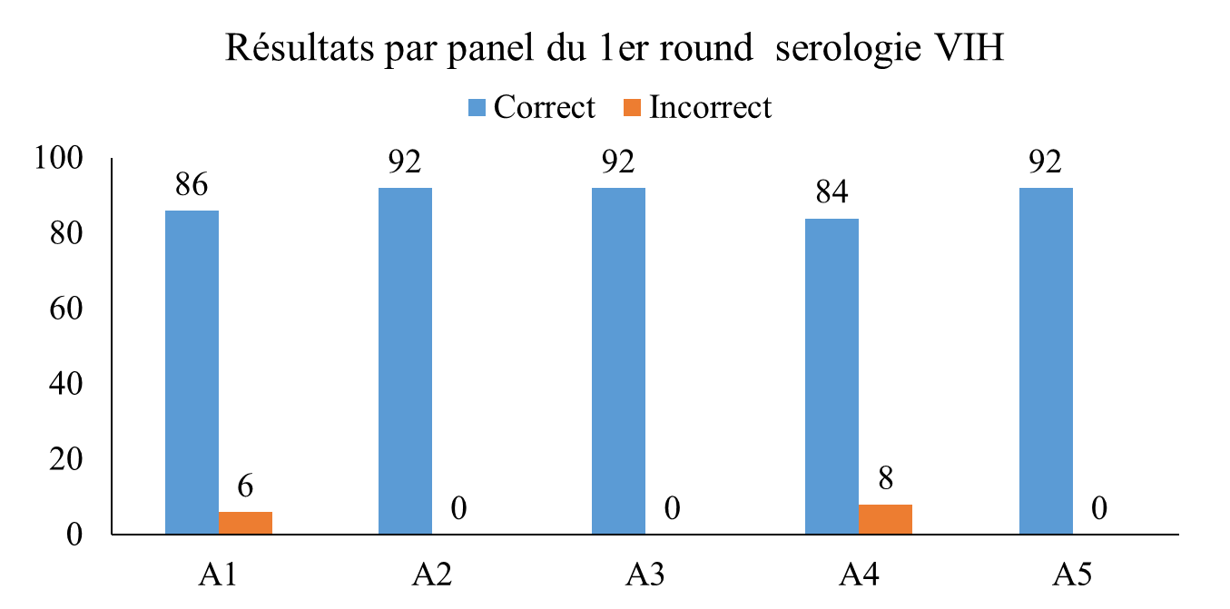
3. SUMMARY OF RESULTS BY PANEL (1/2)
Positive
Negative
Negative
Positive
Negative

Slide 35
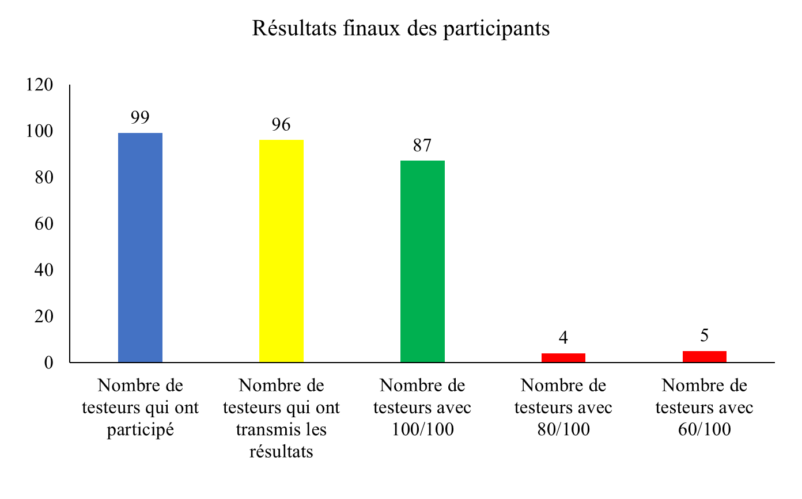
3. REVIEW OF FINAL RESULTS (2/2)
Success : 90,62%
Participation: 96,97%
Failure: Proportion: 9,37%

Slide 36




ACKNOWLEDGEMENTS

Slide 37
THANK YOU FOR YOUR CONTINUED ATTENTION

Slide 38
CDC Sierra Leone Laboratory Quality Systems Project
RTCQI Best Practices workshop for Africa Region in Cape Town, South Africa 3rd -7th June 2024.
HIV Rapid Test Dried Tube Specimen (DTS) Proficiency Testing Best Practices
Case Study: Sierra Leone

Slide 39
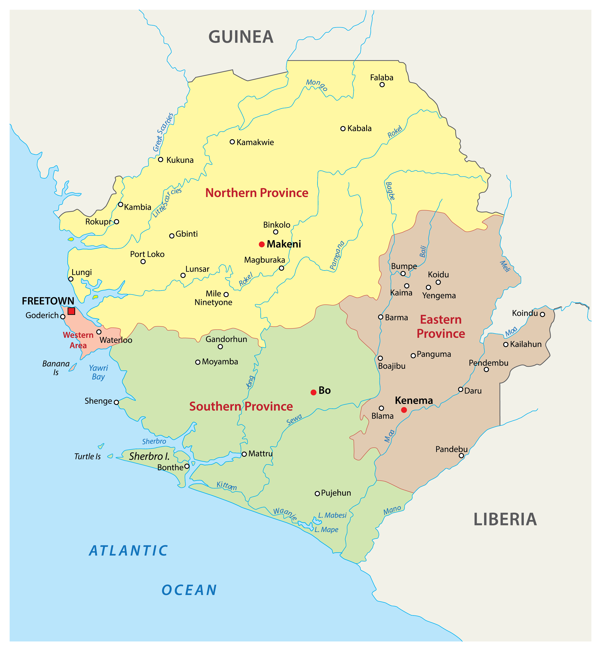
Country Profile
Sierra Leone (SL) is in the western part of Africa
It has 16 Districts with a population of about 8.4 Million (2021 Census)
It has16 Ethnic groups, but Krio is largely spoken
The formal language is English
The capital city, Freetown, commemorates the nation’s slave-trade history
SL is known for the white-sand beaches lining the Freetown Peninsula
SL is part of the River Union and ECOWAS

Slide 40
Background
The project was tasked to initiate and sustain a proficiency testing (PT) program in Sierra Leone, starting with 30 priority PEPFAR sites
In collaboration with NACP, the project plans to build structures to eventually cover the whole nation, with the overall goal of ensuring quality HIV testing
This PT targets individual HIV Testing Services (HTS) providers, hence performance is individual-based with interventions taken at site level by IPs to provide corrective actions

Slide 41
Methodology: Activities Implemented
Train & Enroll 30 Participants
Distribute panel
Train staff on HIV PT protocol
Introduced ePT
Baseline assessment; 2022
Completed PT cycle 1 & 2; 2023
Review HIV PT protocol
DTS production
Evaluate performance
Disseminate report
Conduct CAPA
Scaled up to 147 participants

Slide 42
PT Round 1 and 2 Performance Comparison
147 participants were enrolled in each PT round
Total participant response rate increased from 40% to 60%
The valid response rate was relatively high from 27% to 69%
Satisfactory performance rate decreased from 85% to 65%

Slide 43
Challenges
Relocation or transfer of participants from one facility to another.
Limited participation due to shortages of test kits at testing facilities
Limited Partner support towards the training and enrollment of new testers in >960 facilities in the country.

Slide 44
Next Step
Engage Government, stakeholders and other health-supporting partners for the enrolment of non-PEPFAR facilities
Scale up PT participants’ enrolment in PEPFAR and NON-PEPFAR to 450 in the 2024 Round 1 survey
Maximize participants’ utilization of the ePT platform for results entry through training.

Slide 45
Scale up plans
Advocate for budget to cover PT-CQI in 90 to 95% of the country
>90% of testing sites that conduct a test pass PT for all service delivery sites
90 -100% of testers and testing sites achieve certification
100% of laboratory-based testing sites participate in CQI and PT
100% of HIV viral load and EID laboratory-based testing sites participate in CQI while working towards accreditation

Slide 46
Lessons learned
Work with PSM to consider adding test kits during the regular quantification of supplies.
Ensure that test kits are received at the sites before shipping the PT panel to the sites.
Capacitate participants to upload their results to the ePT server.
A stakeholders meeting is important, to get the buy-in of the DHMT, partners and participants for the next PT cycle
Training of laboratory scientists to help with the mentoring and corrective actions helps saturate interventions

Slide 47
Thank You

